Slide 1

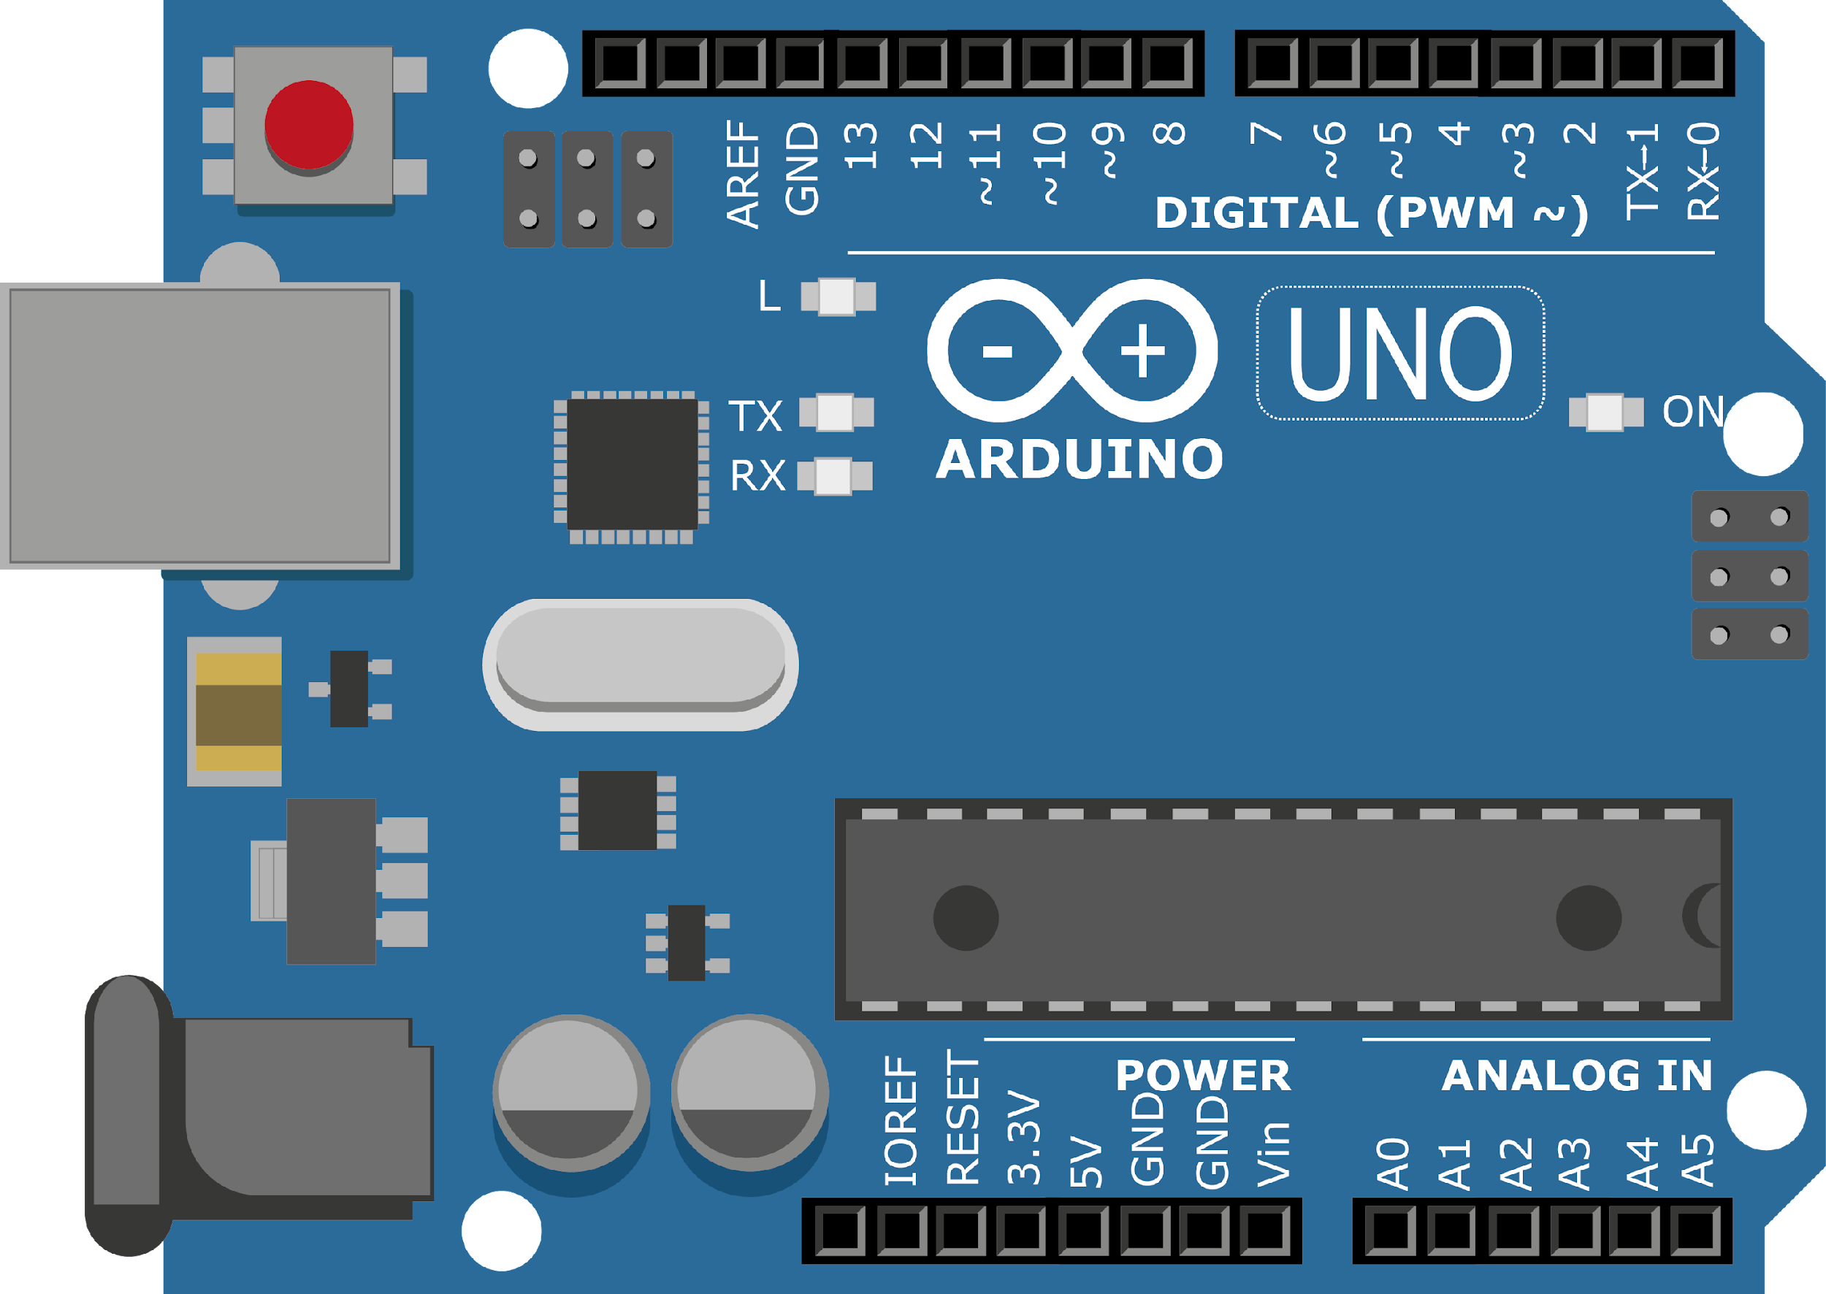
ARDUINO MASTER CLASS
23
Seven Segment

Slide 2
22 AGENDA
02
03
01
Seven segment Working
Basic electronics
Counter seven segment

Slide 3
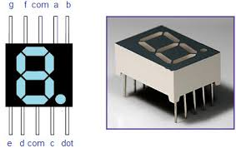
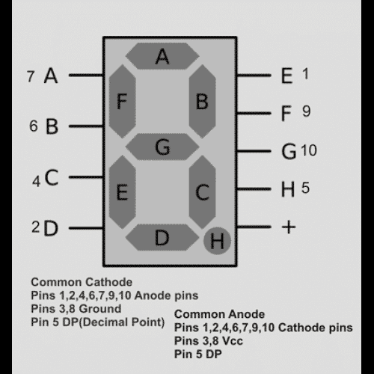
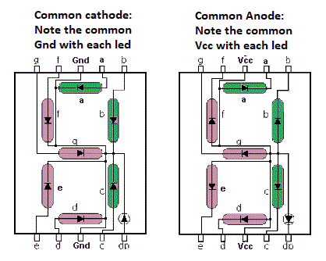
LCD - Liquid Crystal Display
“seven segment display”, consists of seven LEDs (hence its name) arranged in a rectangular fashion as shown. Each of the seven LEDs is called a segment because when illuminated the segment forms part of a numerical digit (both Decimal and Hex) to be displayed.

Slide 4
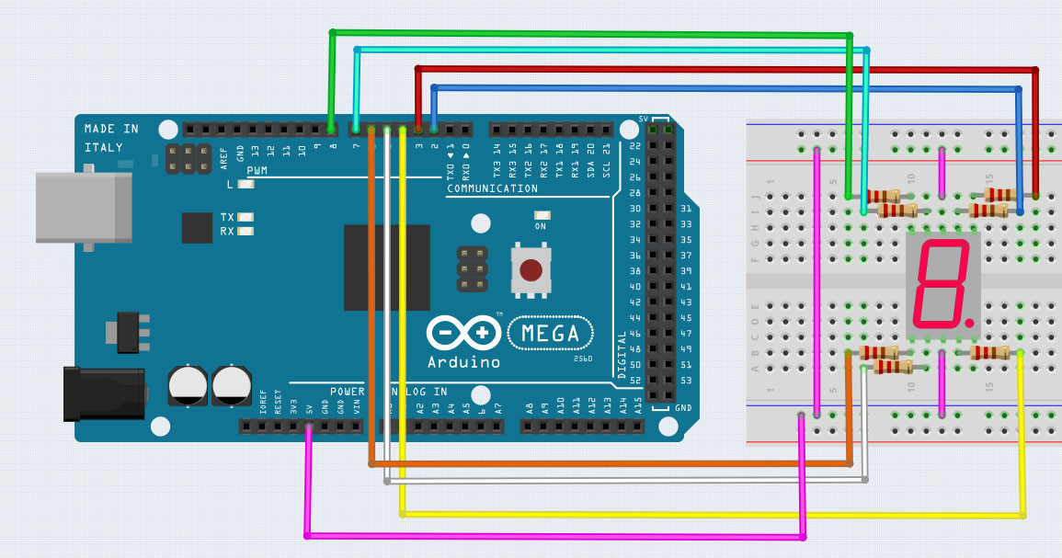
7-Segment Common cathode with Arduino

Slide 5

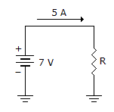
INTERVIEW QUESTIONS
Interrupt & its Types
What is the power in the given circuit ?
RTOS VS OS
OS (Operating System) such as Windows or Unix and an RTOS (Real Time Operating System) found in embedded systems, is the response time to external events. OS’s typically provide a non-deterministic, soft real time response, where there are no guarantees as to when each task will complete, but they will try to stay responsive to the user. An RTOS differs in that it typically provides a hard real time response, providing a fast, highly deterministic reaction to external events.
Interrupt is a signal which has highest priority from hardware or software which processor should process its signal immediately.
Hardware Interrupts & Software Interrupts

Slide 6

THANKS!

